Slide 1
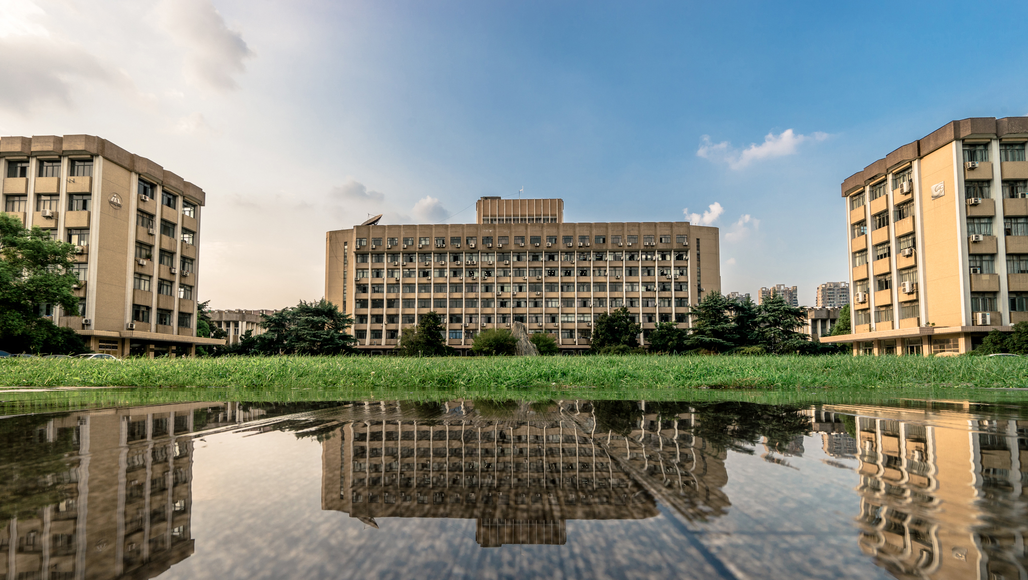



Final Presentation of the 2024 Summer AI Workshop
Attention: in your team’s python notebook template please claim for each part who has made it!
汇报人
何俊濠 姚浩然
王启帆 罗森源
Botbote Khawla
艰苦创业 开拓创新 争创一流
XXX学院XXX班级

Slide 2
Part 1. ML for Adventure Work Dataset
艰苦创业 开拓创新 争创一流

Slide 3


01
Business Understanding
Table of contents
02
Data Understanding & EDA
AGENDA
03
ML Process & Outputs
04
Project Management & Scrum Team Construction
- 艰苦创业 开拓创新 争创一流 -

Slide 4
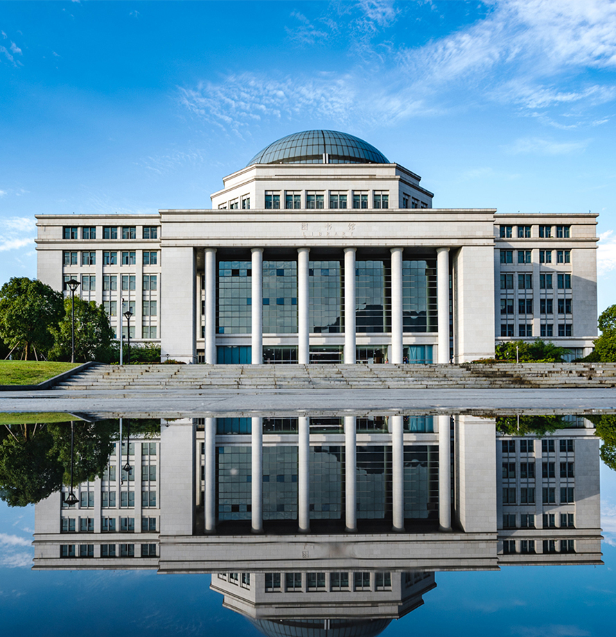
1
Business Understanding
Following the CRISP Data mining cycle to introduce your business understanding
艰苦创业 开拓创新 争创一流

Slide 5
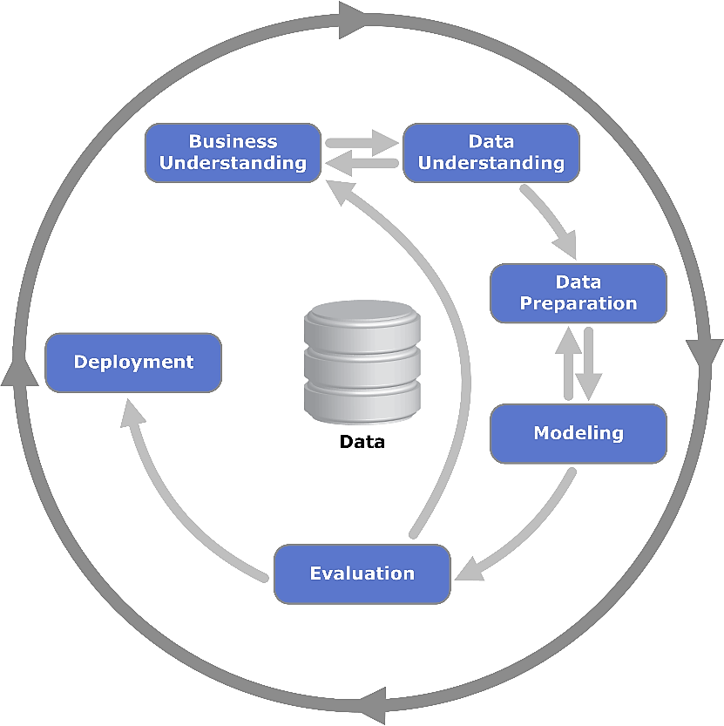

Slide 6
2
Data Understanding & EDA
Introduce your data understanding and the main outputs from your Data Cleaning and the Exploring Data Analysis. You main use screenshots from your notebook

Slide 7
输入你的小标题
添加说明
添加说明
添加说明
添加说明
厚德健行

Slide 8
3
ML Process
Introduce your ML process and the main outputs from it. You may use screenshots from your notebook.
艰苦创业 开拓创新 争创一流

Slide 9


输入你的小标题
输入你的标题
输入你的内容输入你的内容
输入你的标题
输入你的内容输入你的内容
输入你的标题
输入你的内容输入你的内容
厚德健行

Slide 10
4
Scrum Project & Team Work
Following the SMARTER method to describe your considerations on the Project Management and the Team Construction
艰苦创业 开拓创新 争创一流

Slide 11
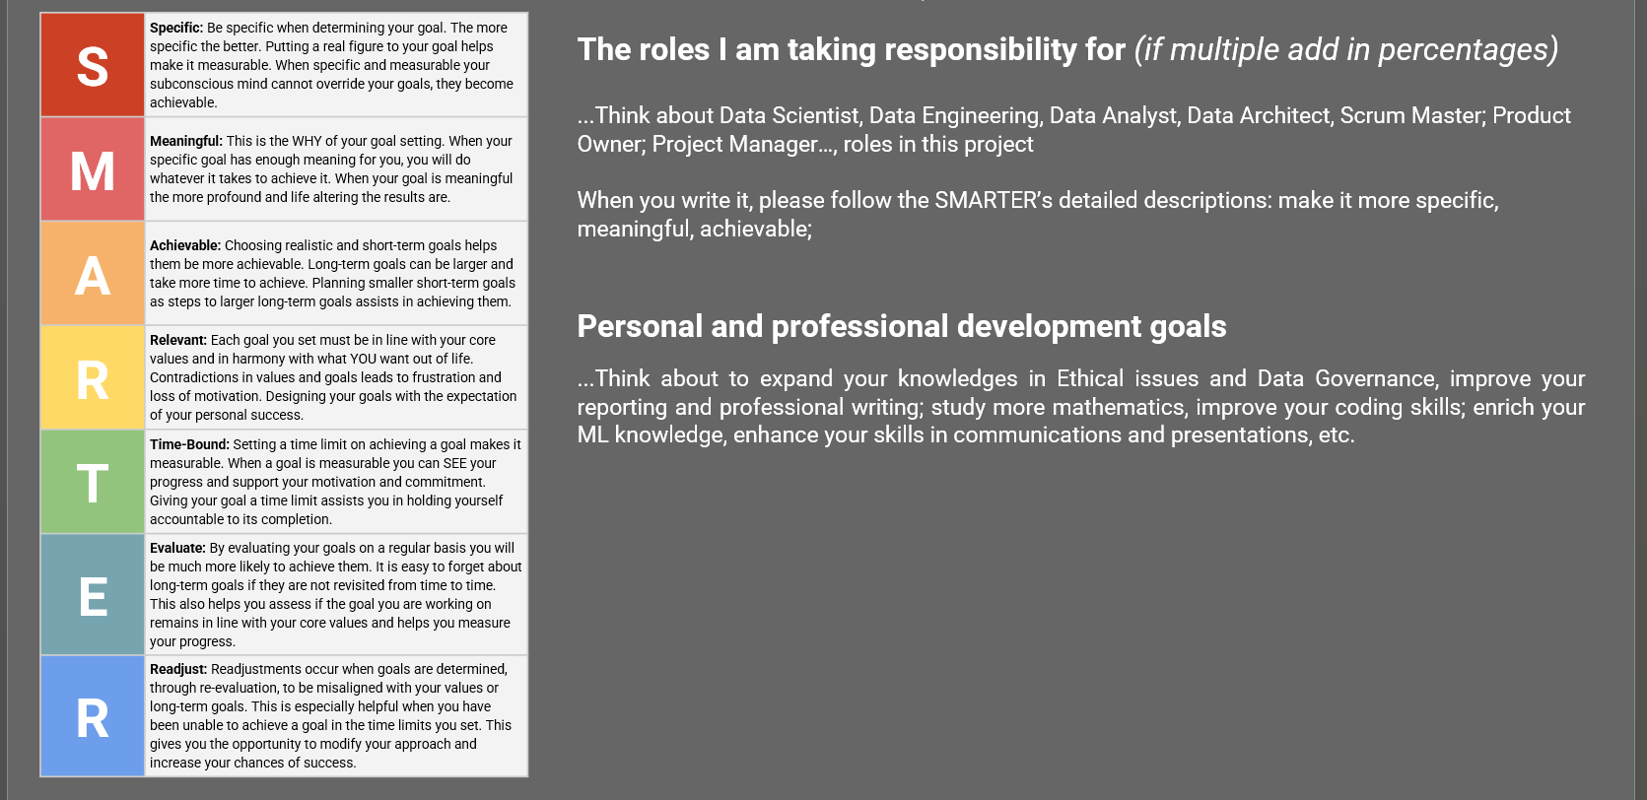
输入你的小标题
厚德健行

Slide 12
Part 2. Medal Challenge (Optional) Using the additional datasets from Prof. Cao
艰苦创业 开拓创新 争创一流

Slide 13
01
Business Understanding
Table of contents
02
Data Understanding & EDA
AGENDA
03
ML Process & Outputs
04
Project Management & Scrum Team Construction
- 艰苦创业 开拓创新 争创一流 -

Slide 14
1
Business Understanding
Following the CRISP Data mining cycle to introduce your business understanding
艰苦创业 开拓创新 争创一流

Slide 15
2
Data Understanding & EDA
Introduce your data understanding and the main outputs from your Data Cleaning and the Exploring Data Analysis. You main use screenshots from your notebook

Slide 16
3
ML Process
Introduce your ML process and the main outputs from it. You may use screenshots from your notebook.
艰苦创业 开拓创新 争创一流

Slide 17
4
Scrum Project & Team Work
Following the SMARTER method to describe your considerations on the Project Management and the Team Construction
艰苦创业 开拓创新 争创一流

Slide 18
谢谢！
艰苦创业 开拓创新 争创一流

